Slide 1
English Stylistics
Week 3
Lexical features I

Slide 2
Course requirements
Participation
→ class attendance, punctuality
→ discussion, Q&A, in-class writing, etc.
Distraction
→ Cell phones, laptops, and other devices

Slide 3
Review
Style – content, form, users, function
Stylistics – a branch of linguistics
Stylistic features: lexical, syntactic, phonological, etc .
Impression → description → interpretation

Slide 4
Lexical features (3 weeks)
Word formation
Word types
English words of different origins
Register and lexical choices
Rhetorical devices

Slide 5
Word-formation processes
Derivation (or Affixation)
Compounding
Blending and Clipping
Abbreviations, acronyms, initialisms
Neologism (coinage)
Borrowing and calque (loan translation)

Slide 6
Examples
smog
CIA
world-class
lab
staycation
YOLO
flu
honey moon

Slide 7
Stylistic effects of coinage
In-class reading: Text 6
The power of “naming”

Slide 8
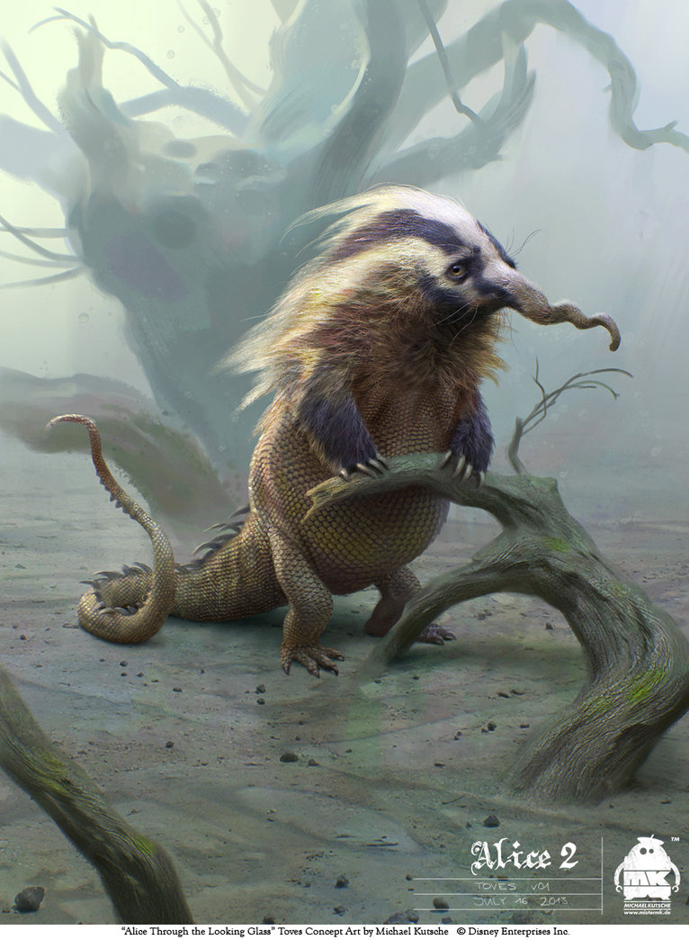
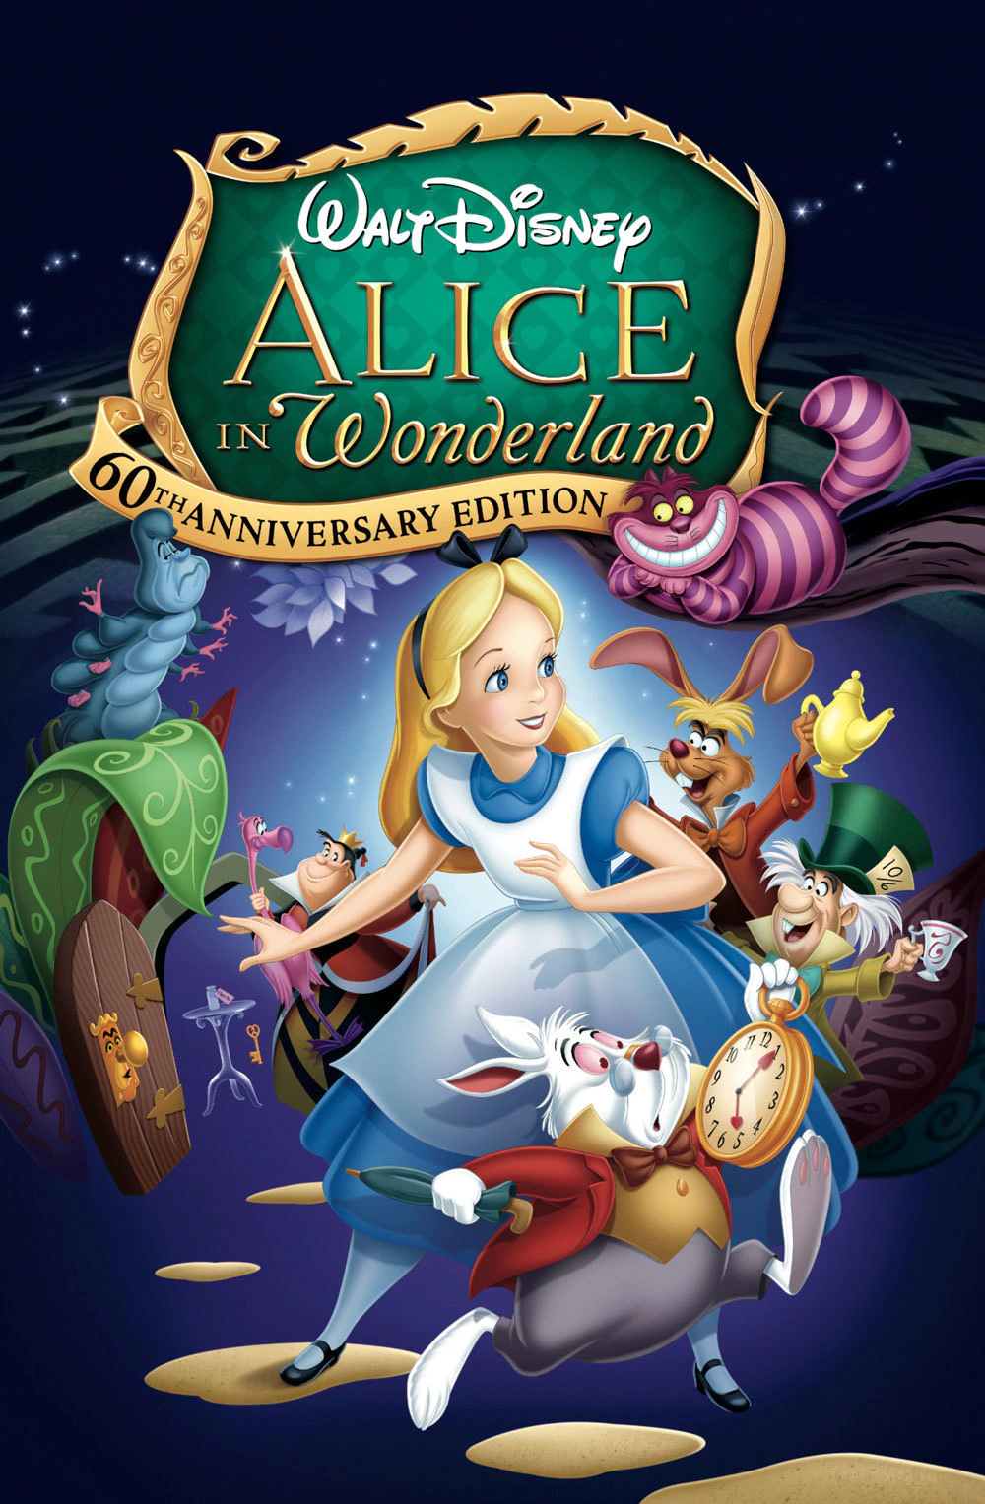
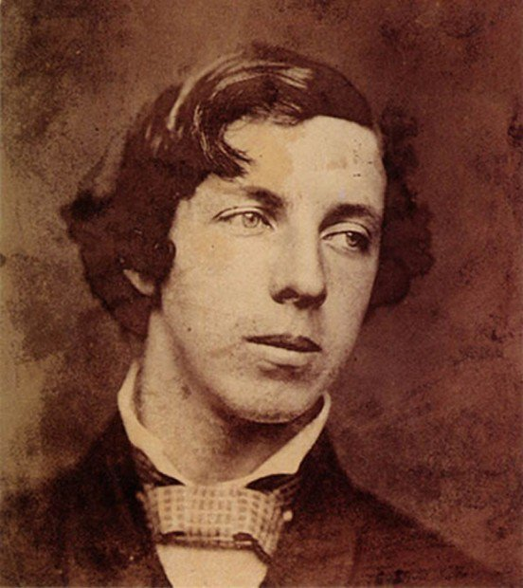
Lewis Carroll (1832-1898)

Slide 9
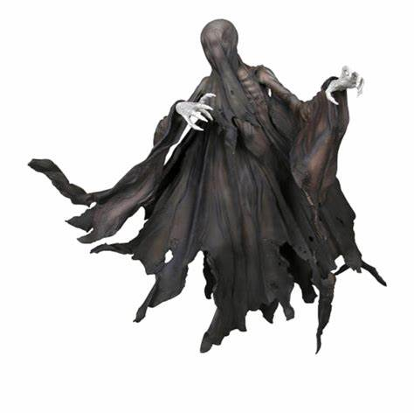
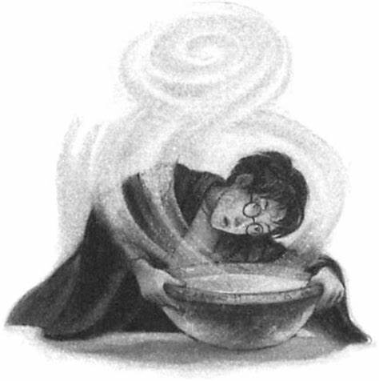
“Pensieve” and “Dementor” in HP series

Slide 10
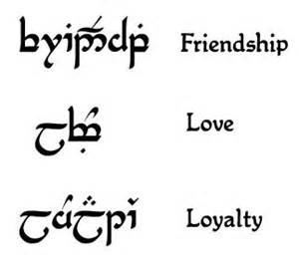
Creation of new “languages”
Elvish (The Lord of the Rings)
Klingon (Star Trek)

Slide 11
Compound adjectives
“Not merely physical labor, I should add, but absolutely spine-bending, lung-racking, gut-ripping, ligament-tearing, and ball-breaking physical labor.” (from Hyperion)

Slide 12
In-class activities
Use a series of at least 3 compound adjectives to describe an exceptional experience
Examples: eye-opening, mouth-watering, single-handed

Slide 13
Word types
CONTENT words
(nouns, verbs, adjectives, adverbs)
FUNCTION words
(auxiliaries, prepositions, articles, pronouns, conjunctions)

Slide 14
Distribution of word types in English (BNC data)

Slide 15
In-class reading: Text 7-8
Describe and compare the two rooms.
Who is living there? How is his/her life?

Slide 16
Mini-analysis of the lexical features
Identify the adjectives in the two texts.
Calculate the proportion of adjectives.
→ 135 words (Text 7) and 178 words (Text 8)
What is the effect of this lexical feature?

Slide 17
Text 7
19/135 (14%)
Adjectives about size, color, shape, design, fabric and taste (standard, pleasant, modest, best, modern, proper, scientific)
meticulous and excessive concern of the details
Vanity, conformism and Lack of personality

Slide 18

Babbitt, by S. Lewis (1922)
A satirical novel about American culture and society that critiques the vacuity of middle-class life and the social pressure toward conformity.

Slide 19
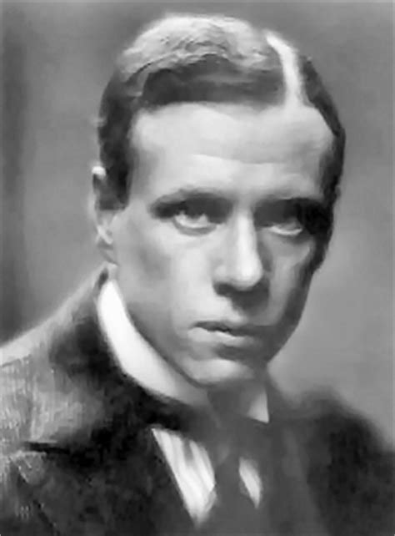
Sinclair Lewis (1885-1951)
Nobel prize in literature (1930)
"for his vigorous and graphic art of description and his ability to create, with wit and humor, new types of characters."

Slide 20
Text 8
10/178 (6%) (first two paragraphs)
Mostly about color (white), size and shape
Recurrence of “same” and “white”
A bare room with little human touch
A strong sense of deprivation

Slide 21
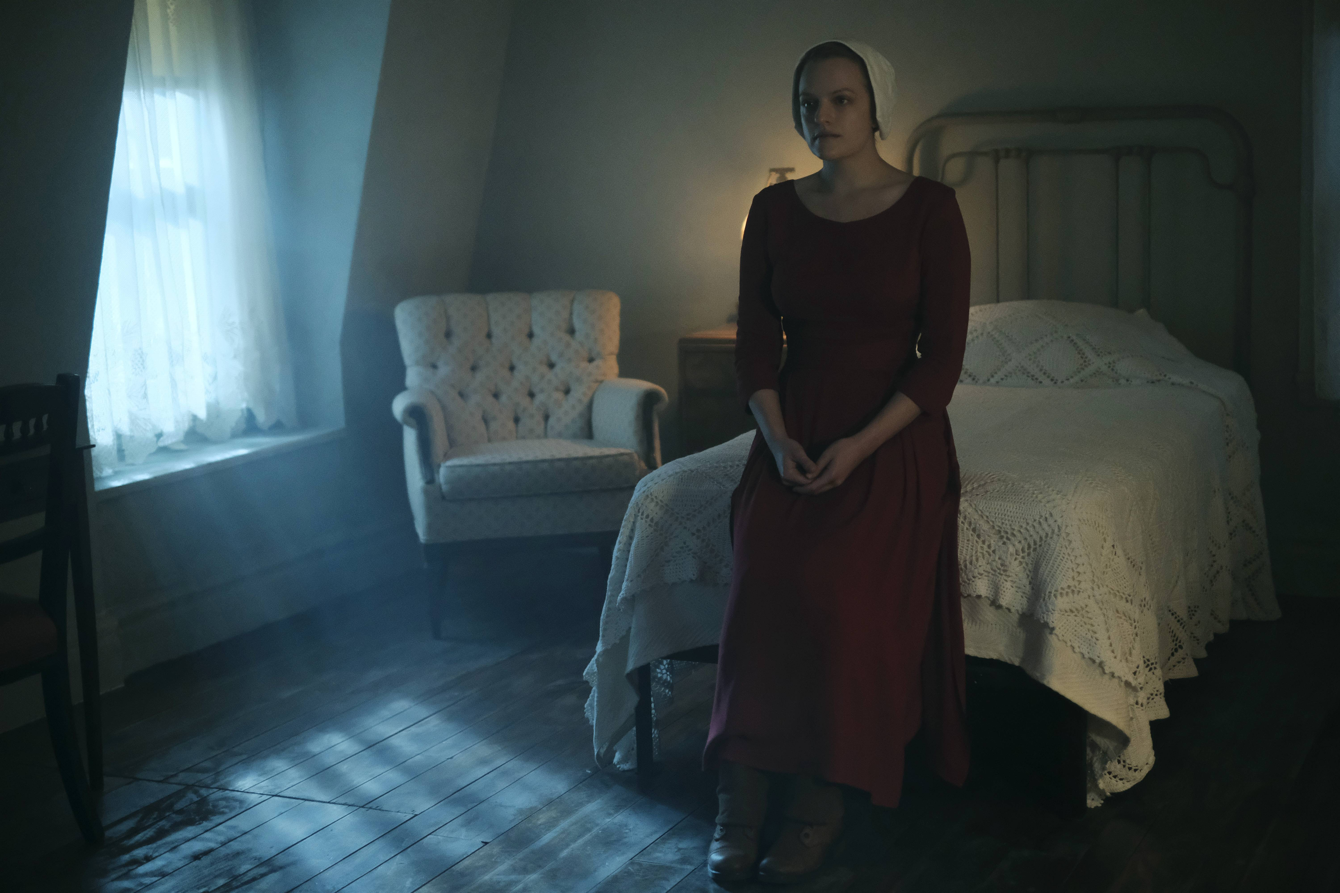
The room in the adapted TV episode

Slide 22

The Handmaid’s Tale, by Margaret Atwood

Slide 23
Next class
Different nouns and verbs
English words of different origins

